Slide 1
Green Paris
Linked Data for the bicycle activity

Slide 2
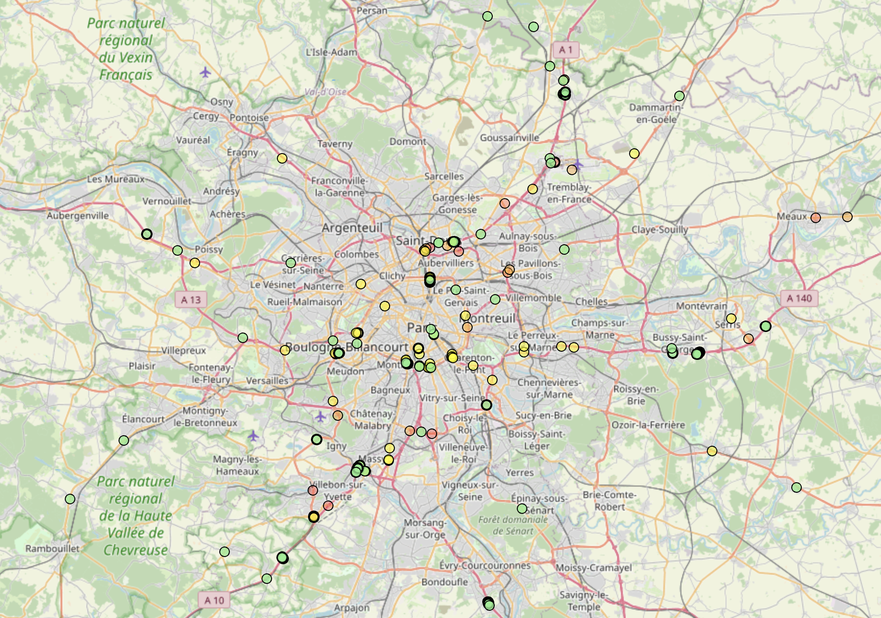
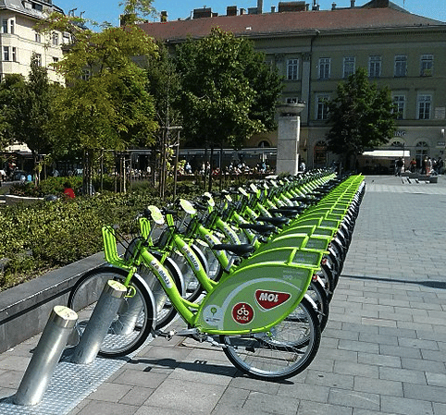
Application Overview
Better Urban Experience:
Information about the bicycle stations ->Amount, Location
Location of bicycles on specific date and street
Data is linked with outside world ->more information and research can be done
Example: What was happening at the “Street xX” on the “2nd of November” and how did it affect the bicycle traffic

Slide 3

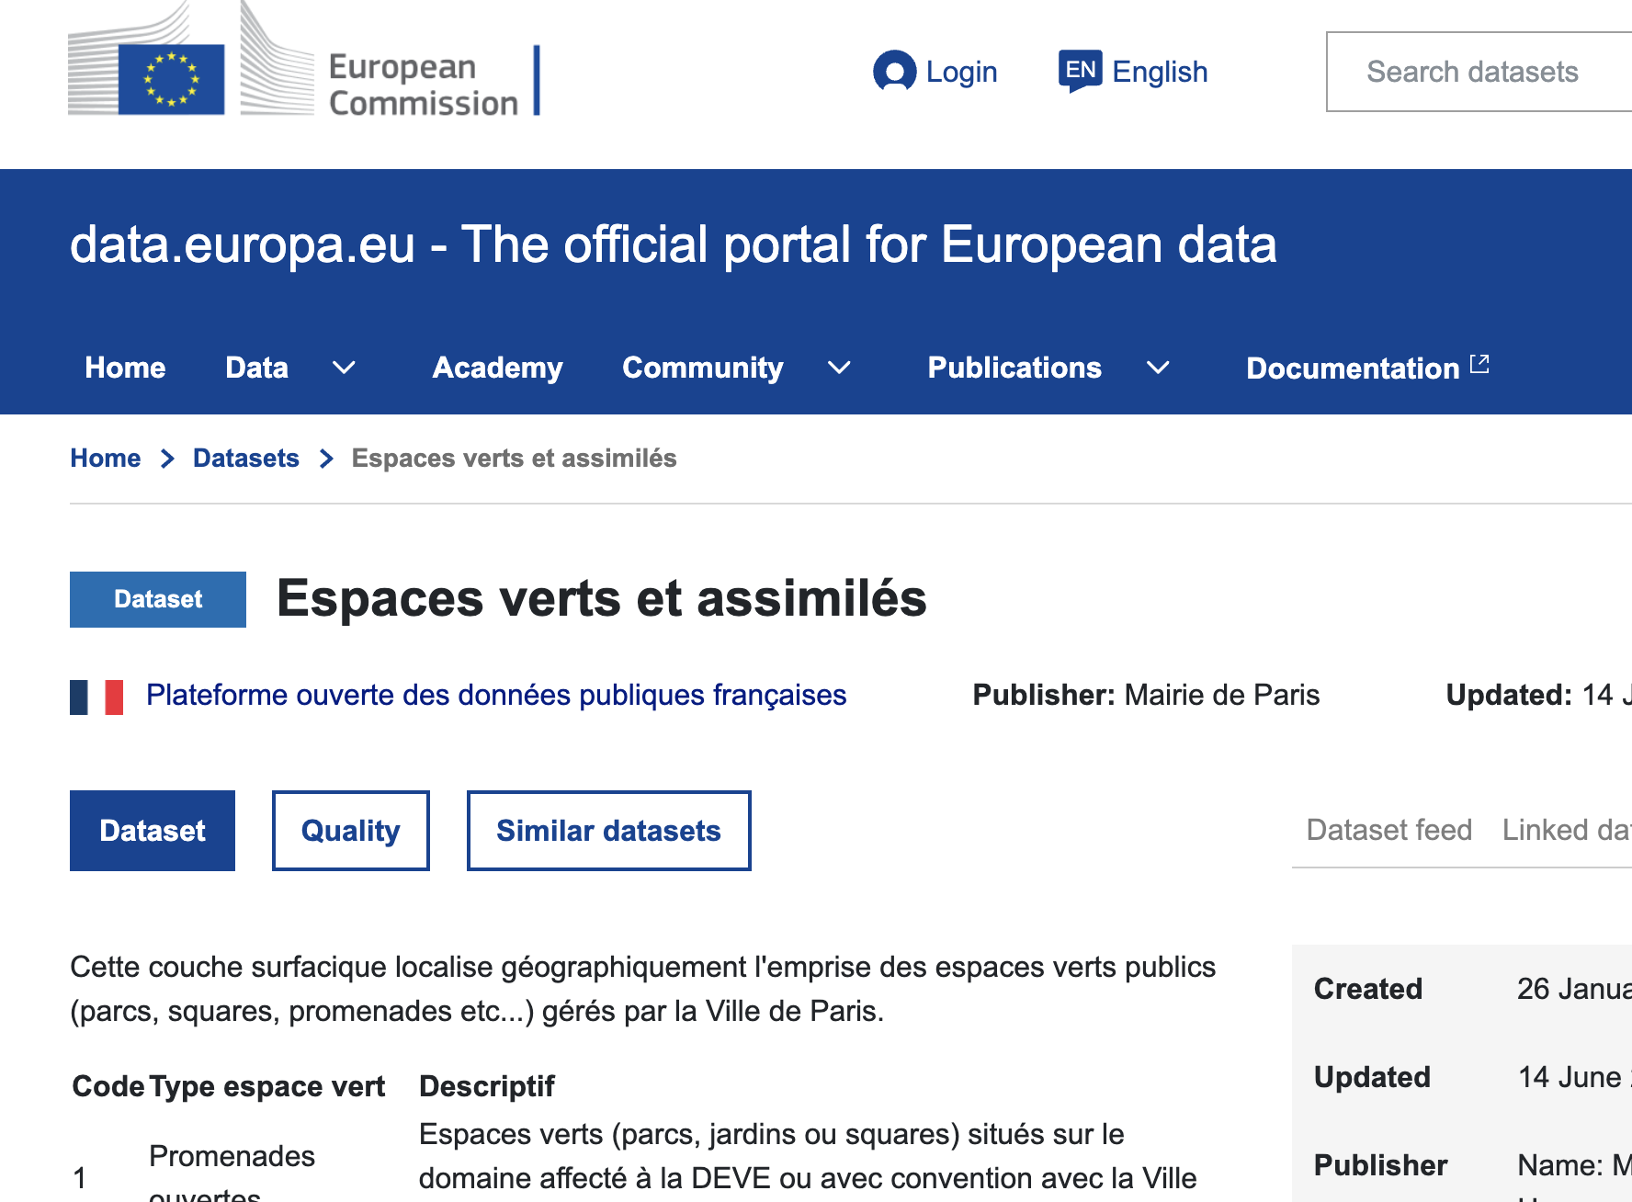
Where we got the data
European Data Portal
Because:
Open Data access -> allows for transparency and collaboration
Comprehensive Data source

Slide 4

License of the data
Editor and Owner: City Hall of Paris
General Conditions for Reuse
You can copy, distribute and use the work .
You can produce works from the information.
You can modify, transform and build from the work.
…

Slide 5
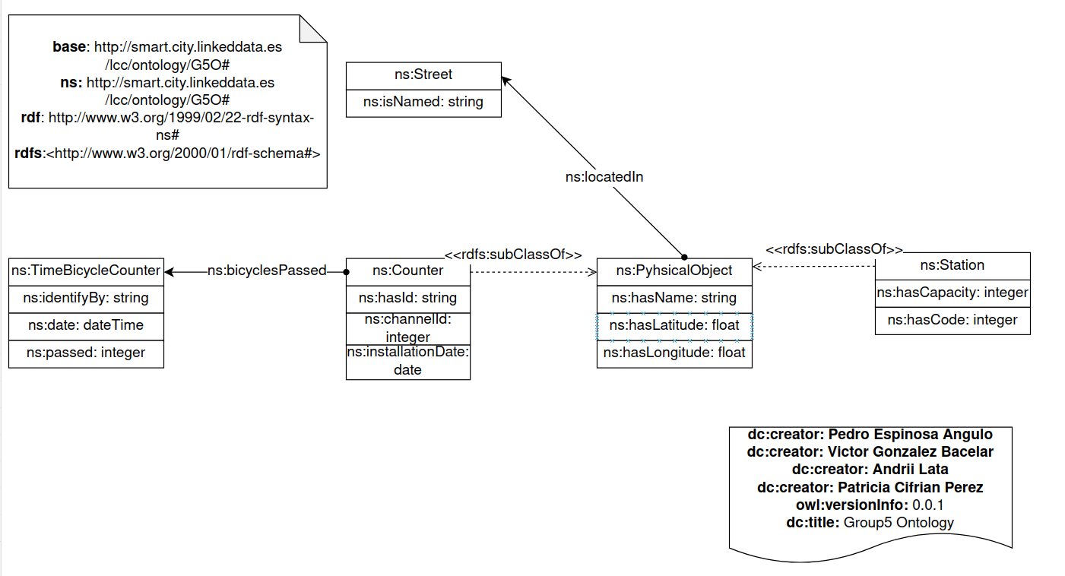
ONTOLOGY

Slide 6
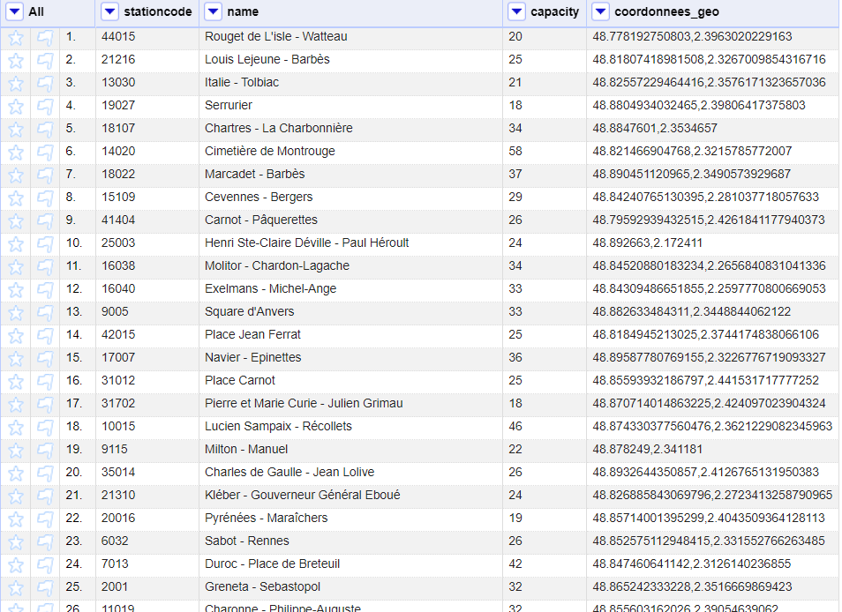
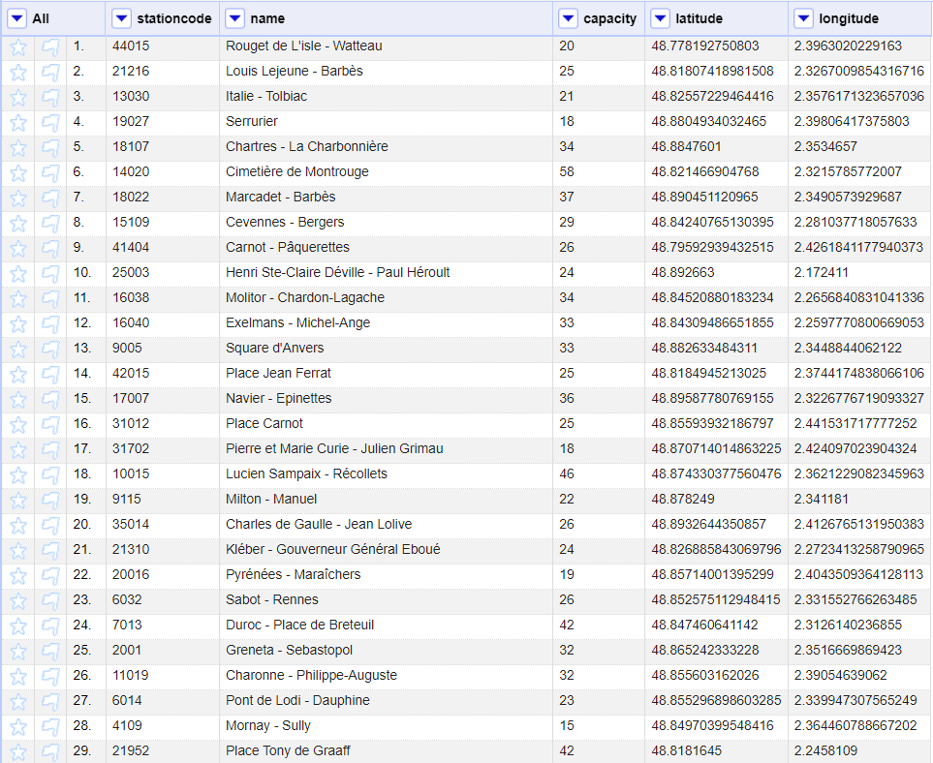
velib-emplacement-des-stations

Slide 7
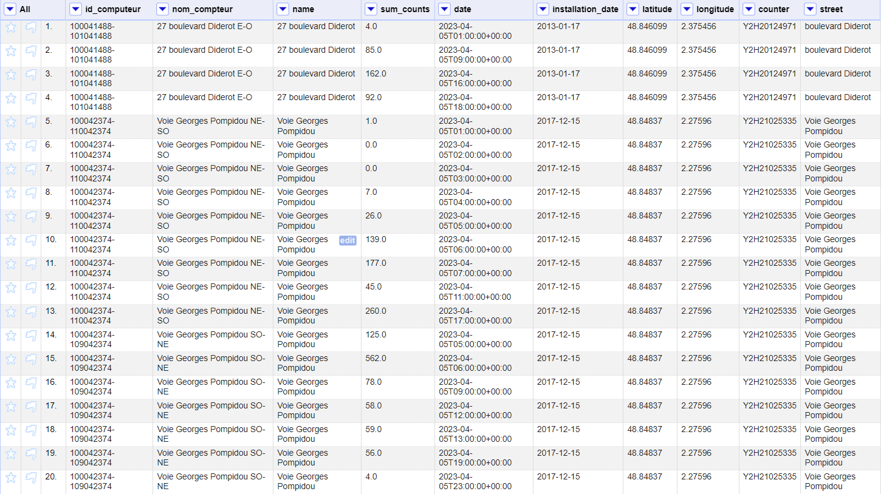
count

Slide 8
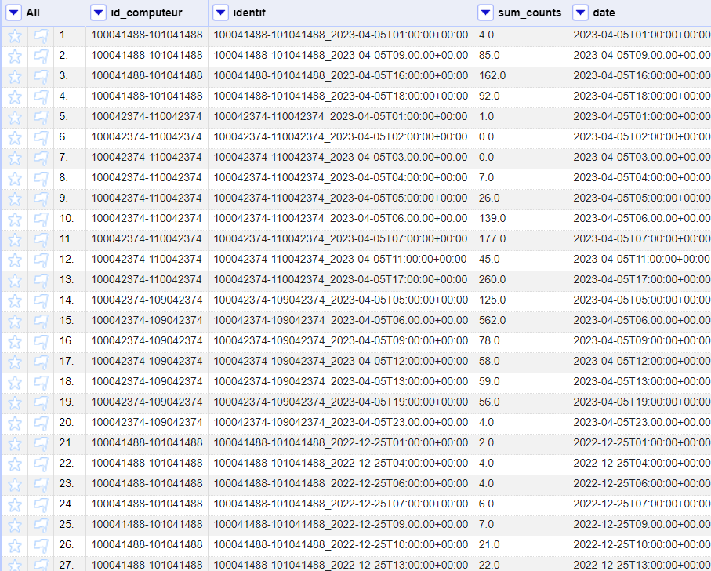
Count update

Slide 9
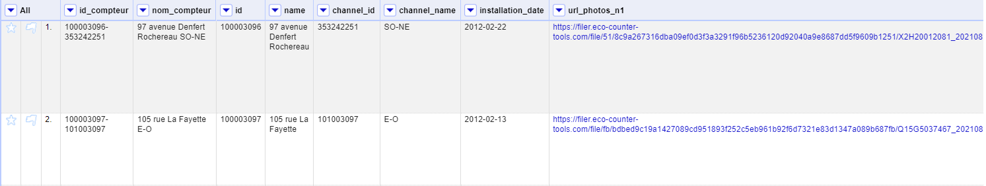
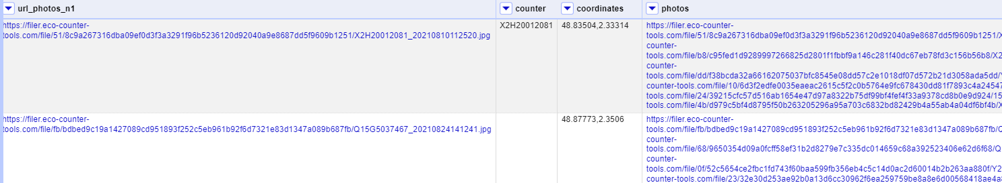
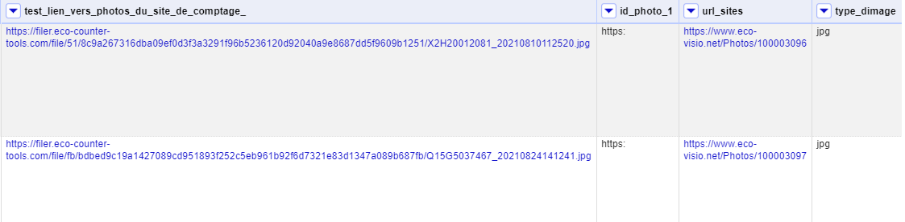
comptage vélo compteurs

Slide 10
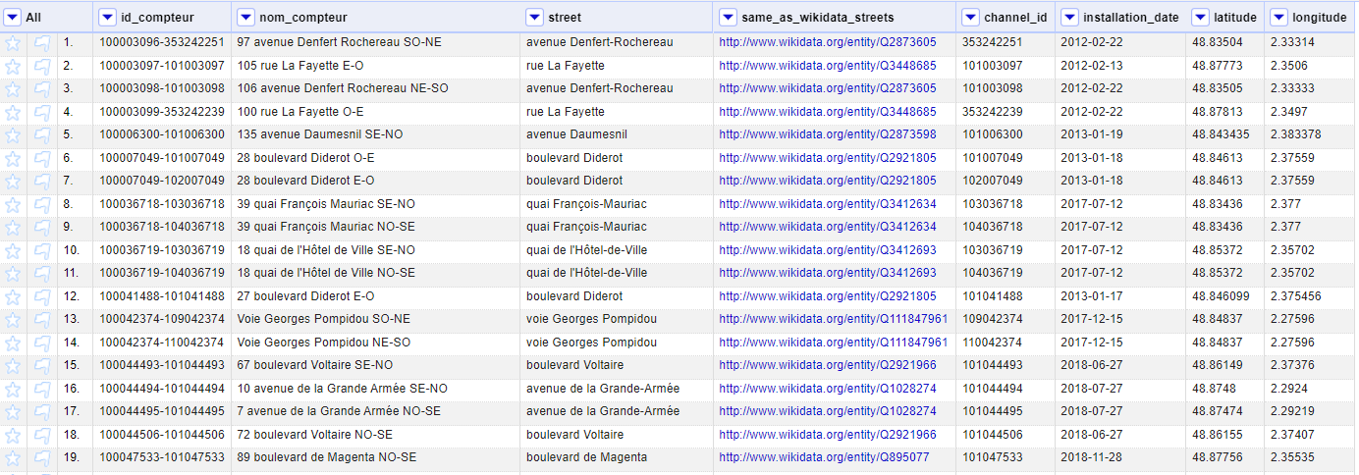
comptage vélo compteurs updated with links

Slide 11
Mappings
TriplesMap1: Stations
Logical Source: "velib-emplacement-des-stations-updated.csv"
Subject: Stations
Predicates:
hasName
hasCapacity
hasLatitude
hasLongitude
hasCode.
TriplesMap2: TimeBicycleCounter
Logical Source: "count-updated.csv"
Subject: TimeBicycleCounter
Predicates:
date
passed
identifyBy

Slide 12
Mappings
TriplesMap12: Counter
Logical Source: "count-updated.csv"
Subject: Counter
Predicates:
bicyclesPassed
TriplesMap3: Counters
Logical Source: "comptage-velo-compteurs-updated-with-links.csv"
Subject: Counters
Predicates:
hasId
channelId
locatedIn
hasLatitude
hasLongitude
installationDate
hasName

Slide 13
Mappings
TriplesMap4: Streets
Logical Source: "comptage-velo-compteurs-updated-with-links.csv"
Subject: Streets
Predicates:
isNamed
owl:sameAs

Slide 14
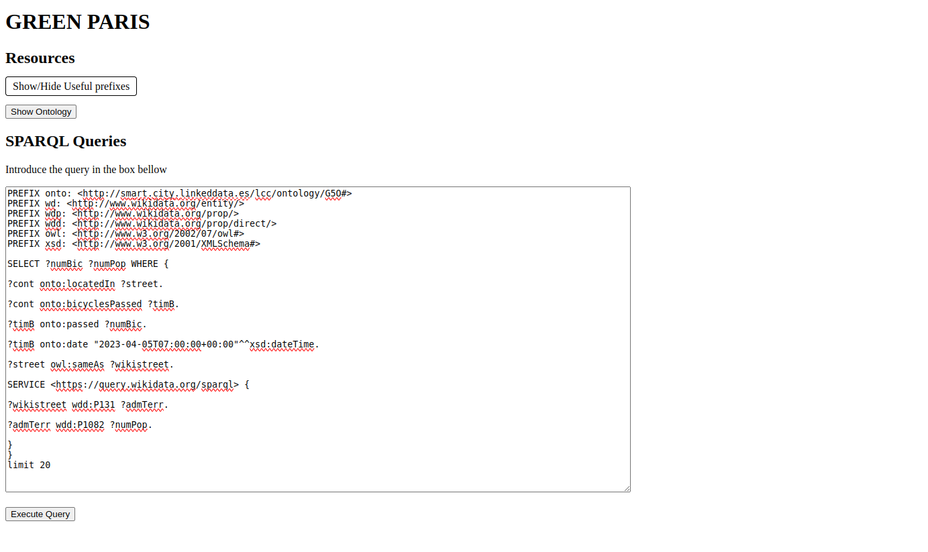
DEMO

Slide 15
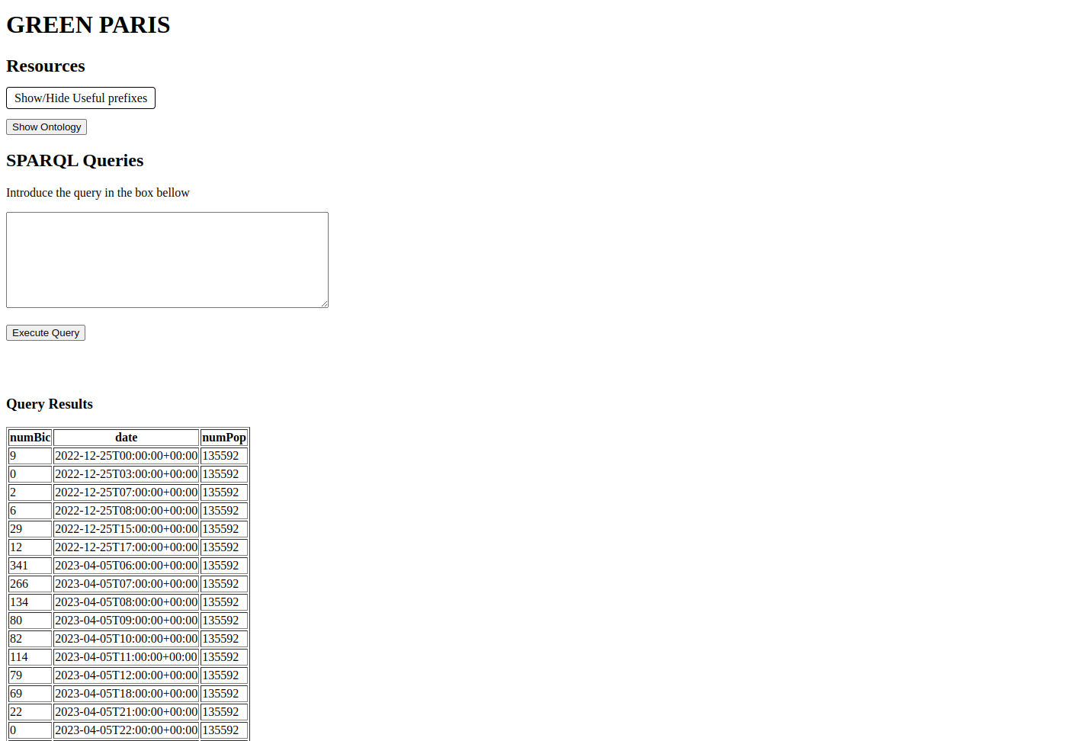
DEMO

Slide 16
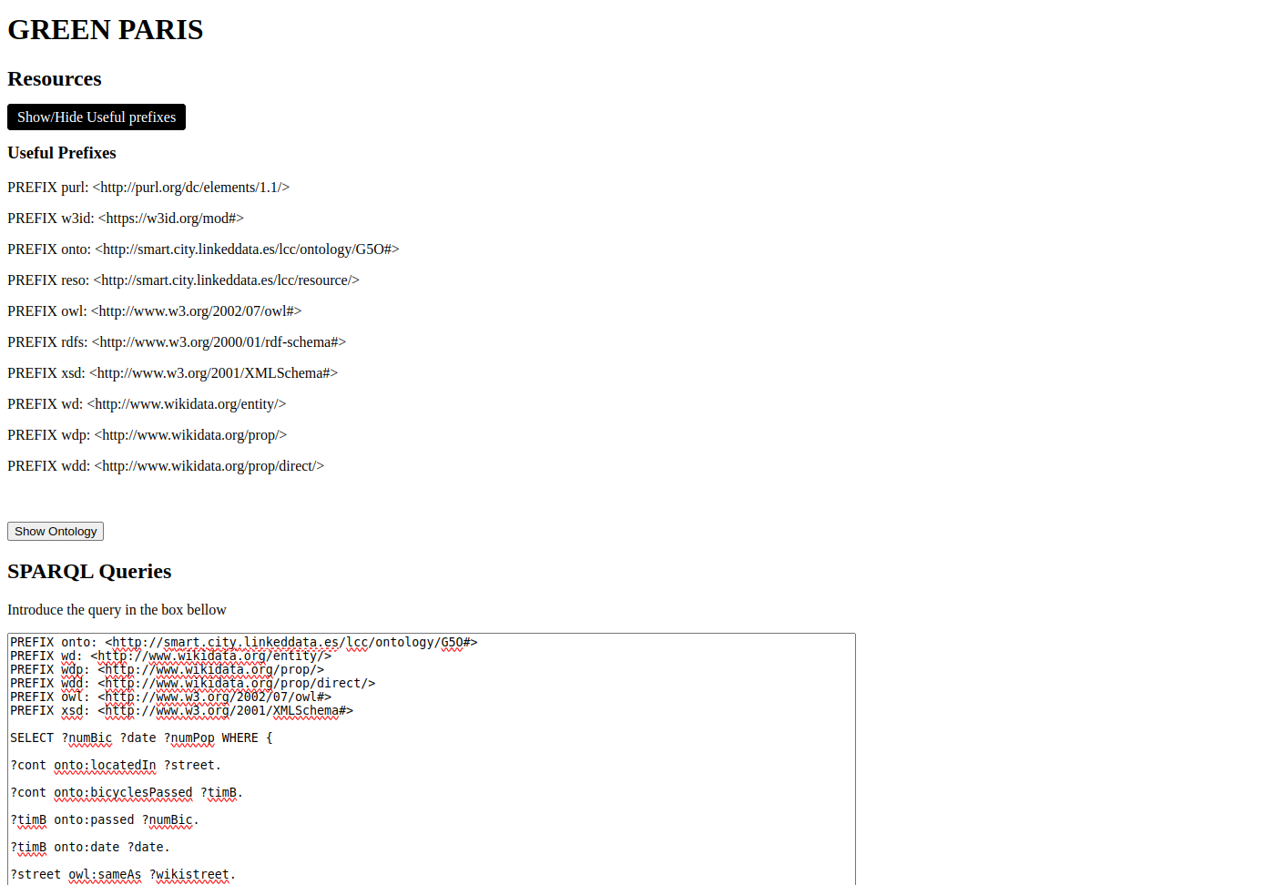
DEMO

